Slide 1
Econ 7900
Statistics for Data Science
Instructor: CAO Kang Hua 曹康華
Lecture 5
Comparing Two Groups

Slide 2
Dependent and Independent Samples
Most comparisons of groups use independent samples from the groups. The observations in one sample are independent of those in the other sample.
  Example: Randomized experiments that randomly allocate subjects to two treatments
  Example: An observational study that separates subjects into groups according to their value for an explanatory variable
Notes:
2

Slide 3
Dependent and Independent Samples
Dependent samples result when the data are matched pairs – each subject in one sample is matched with a subject in the other sample.
      Example: Set of married couples, the men being in one sample and the women in the other
    Data from dependent samples need different statistical methods than data from independent samples.
Notes:
3

Slide 4
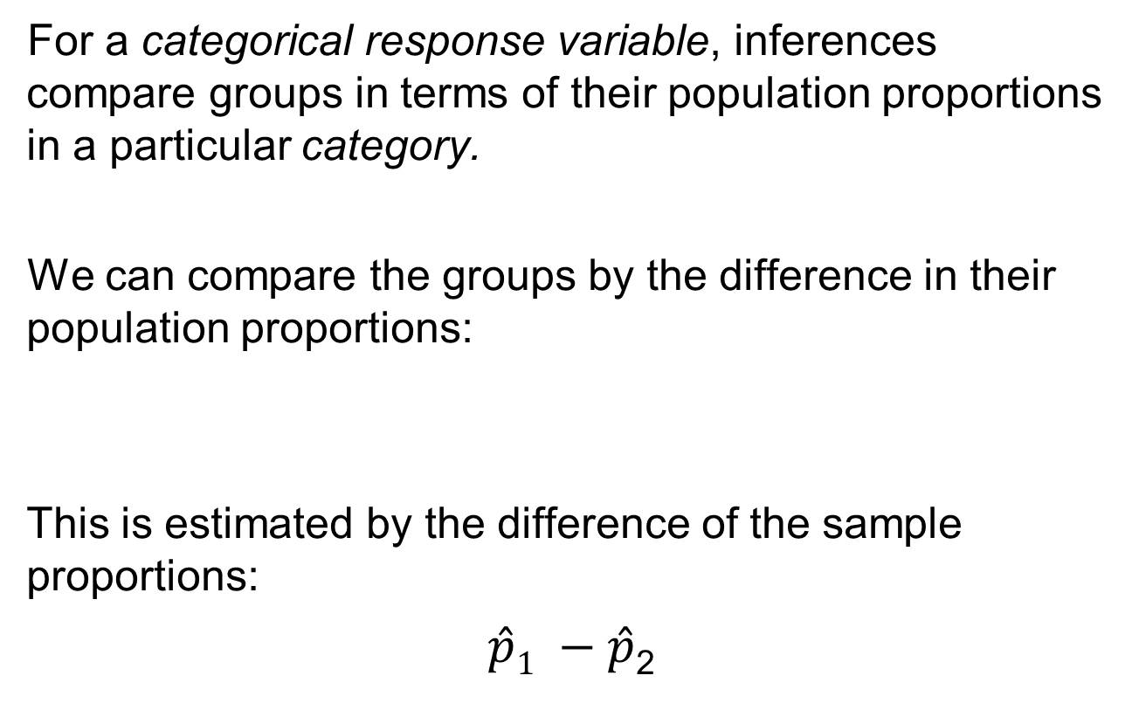
Categorical Response: Comparing Two Proportions
For a categorical response variable, inferences compare groups in terms of their population proportions in a particular category.
We can compare the groups by the difference in their population proportions:
This is estimated by the difference of the sample proportions:
$\hat{p}1 −\hat{p}$₂
Notes:
4

Slide 5
Example: Aspirin, the Wonder Drug
Experiment:
Results of a recent meta-analysis combined the results of eight related studies with a minimum duration of treatment of four years to determine the effects of aspirin on the risk of cancer death.
  All experimental trials used were randomized and double-blind
Of the 25,570 individuals studied, 347 of those in the control group died of cancer, whereas 327 in the aspirin treatment group died of cancer within 20 years following the study.
Notes:
5

Slide 6
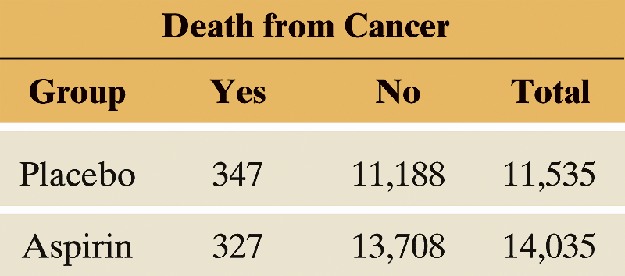
Example: Aspirin, the Wonder Drug
Results displayed in a contingency table:
Table 10.1 Whether or Not Subject Died of Cancer, for Placebo and Aspirin Treatment Groups
Notes:
6

Slide 7
Example: Aspirin, the Wonder Drug
What is the response variable?
  The response variable is whether the subject died from cancer, with categories ‘yes’ or ‘no’.
What are the groups to compare?
  The groups to compare are:
    Group 1: Subjects who took a placebo.
    Group 2: Subjects who took aspirin.
Notes:
7

Slide 8
Example: Aspirin, the Wonder Drug
Estimate the difference between the two population parameters of interest.
The proportion who died of cancer is represented by
  p₁ for taking placebo and
  p₂ for taking aspirin.
Notes:
8

Slide 9
Example: Aspirin, the Wonder Drug
The sample proportions of death from cancer were:
  for the n₁ = 11,535 in the placebo group and:
  for the n₂ = 14,035 in the aspirin group.
Notes:
9

Slide 10
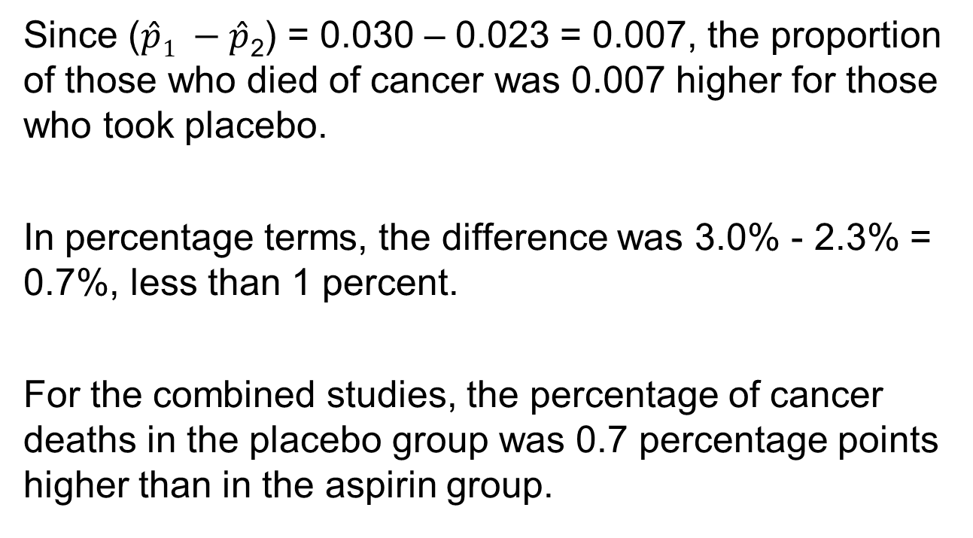
Example: Aspirin, the Wonder Drug
Since ($\hat{p}1 −\hat{p}$₂) = 0.030 – 0.023 = 0.007, the proportion of those who died of cancer was 0.007 higher for those who took placebo.
In percentage terms, the difference was 3.0% - 2.3% = 0.7%, less than 1 percent.
For the combined studies, the percentage of cancer deaths in the placebo group was 0.7 percentage points higher than in the aspirin group.
Notes:
10

Slide 11
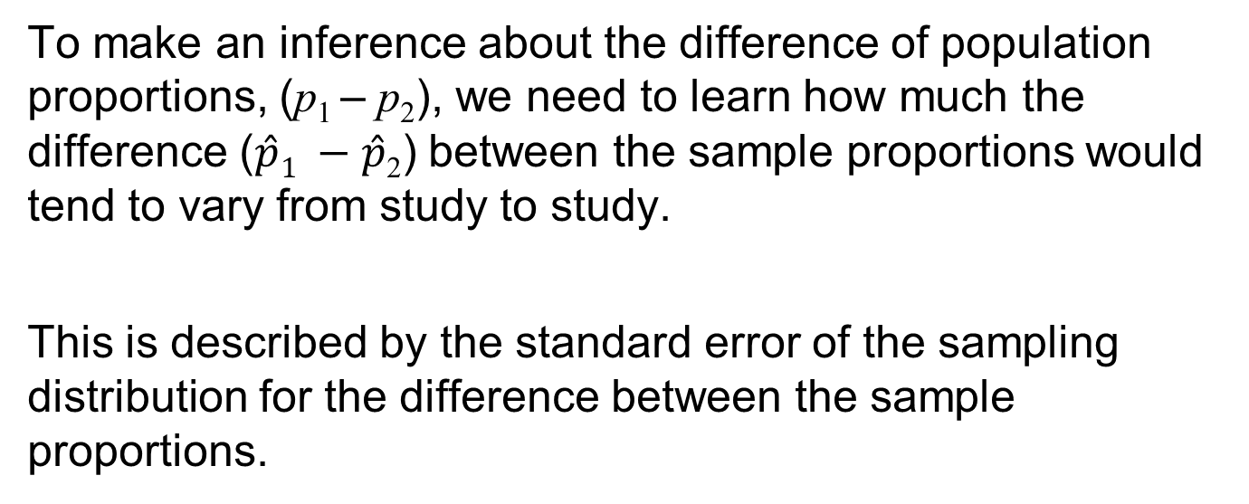
Example: Aspirin, the Wonder Drug
To make an inference about the difference of population proportions, (p₁ – p₂), we need to learn how much the difference ($\hat{p}1 −\hat{p}$₂) between the sample proportions would tend to vary from study to study.
This is described by the standard error of the sampling distribution for the difference between the sample proportions.
Notes:
11

Slide 12
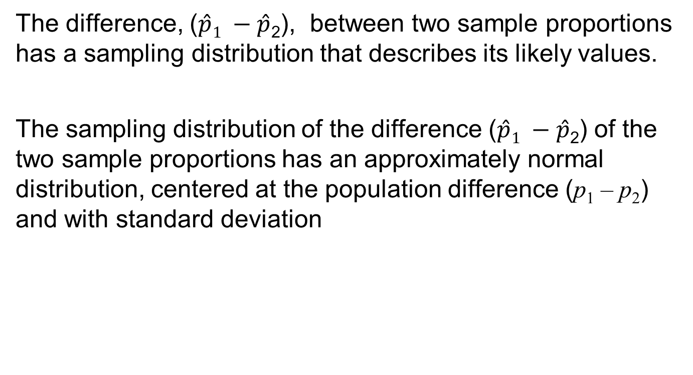
Sampling Distribution of the Difference Between Two Sample Proportions
The difference, ($\hat{p}1 −\hat{p}$₂), between two sample proportions has a sampling distribution that describes its likely values.
The sampling distribution of the difference ($\hat{p}1 −\hat{p}$₂) of the two sample proportions has an approximately normal distribution, centered at the population difference (p₁ – p₂) and with standard deviation
Notes:
12

Slide 13
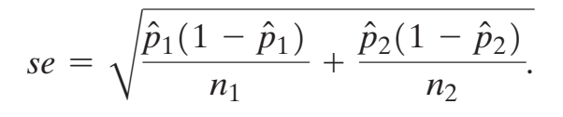
Sampling Distribution of the Difference Between Two Sample Proportions
In practice, we will have to estimate the standard deviation because it depends on the unknown population proportions. This gives the standard error of the difference, which we will need to construct a confidence interval.
Notes:
13

Slide 14
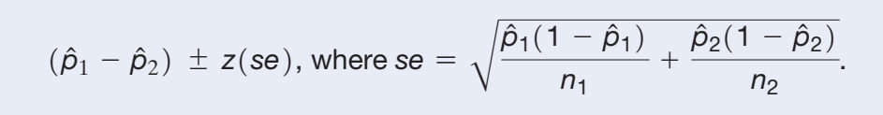
Confidence Interval for the Difference Between Two Population Proportions
The z-score depends on the confidence level.
This method requires:
  Categorical response variable for two groups.
  Independent random samples for the two groups.
  Large enough sample sizes so that there are at least 10 “successes” and at least 10 “failures” in each group.
Notes:
14

Slide 15
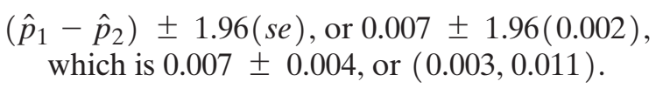
Example: Comparing Cancer Death Rates for Aspirin and Placebo
A 95% confidence interval for (p₁ – p₂) is:
The inference at the 95% confidence level that (p₁ – p₂) is between 0.003 and 0.011 means that in experiments like this, the population proportion p₁ of cancer deaths for those taking placebo would be between 0.003 higher and 0.011 higher than the population proportion p₂ of cancer deaths for those taking aspirin.
Notes:
15

Slide 16
Example: Comparing Cancer Death Rates for Aspirin and Placebo
The population difference (0.003, 0.011) is small.
Even though it is a small difference, it may be important in public health terms.
For example, a decrease of 0.01 over a 20 year period in the proportion of people dying from cancer would mean 2 million fewer people dying from cancer.
Notes:
16

Slide 17
Example: Comparing Cancer Death Rates for Aspirin and Placebo
Benefit was consistent across the different trial populations from the different randomized studies, suggesting that the findings have broader scope of generalization.
Before concluding that aspirin benefits a larger population, it is important to replicate the study to see if results are similar or different for populations used in this study and other populations.
Notes:
17

Slide 18
SUMMARY: Interpreting a Confidence Interval for a Difference of Proportions
Check whether 0 falls in the CI. If so, it is plausible that the population proportions are equal.
If all values in the CI for (p₁ – p₂) are positive, you can infer that (p₁ – p₂) > 0, or p₁ > p₂. If all values in the CI for
(p₁ – p₂) are negative, you can infer that (p₁ – p₂) < 0 , or
p₁ < p₂.
The magnitude of values in the confidence interval tells you how large any true difference is. If all values in the confidence interval are near 0, the true difference may be relatively small in practical terms.
Notes:
18

Slide 19
Two-Sided Significance Test for Comparing Two Population Proportions
1. Assumptions:
  Categorical response variable for two groups
  Independent random samples, either from random sampling or a randomized experiment
  n₁ and n₂ are large enough that there are at least five successes and five failures in each group if using a two-sided alternative.
Notes:
19

Slide 20
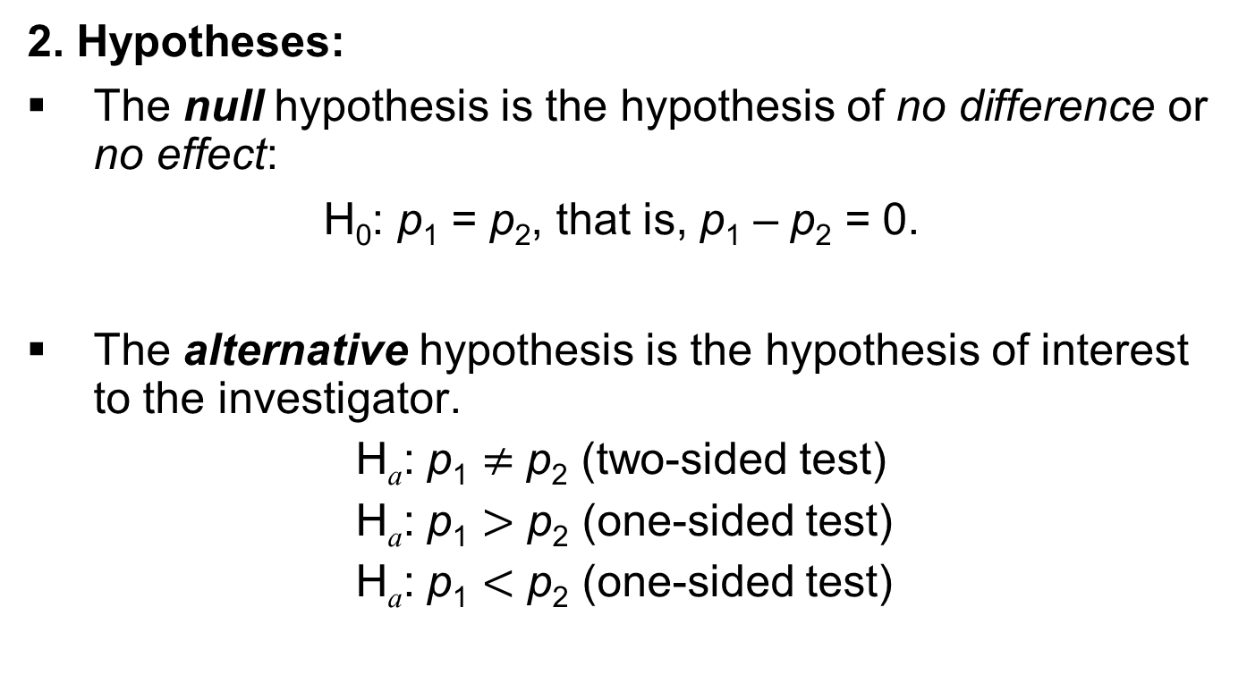
Two-Sided Significance Test for Comparing Two Population Proportions
2. Hypotheses:
The null hypothesis is the hypothesis of no difference or no effect:
H₀: p₁ = p₂, that is, p₁ – p₂ = 0.
The alternative hypothesis is the hypothesis of interest to the investigator.
H_{a}: p₁ $≠$ p₂ (two-sided test)
H_{a}: p₁ $>$ p₂ (one-sided test)
H_{a}: p₁ $<$ p₂ (one-sided test)
Notes:
20

Slide 21
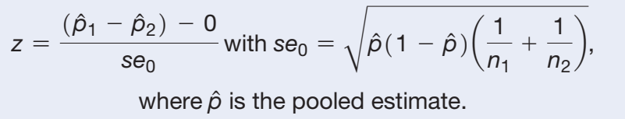
Two-Sided Significance Test for Comparing Two Population Proportions
3. Test Statistic:
Notes:
21

Slide 22
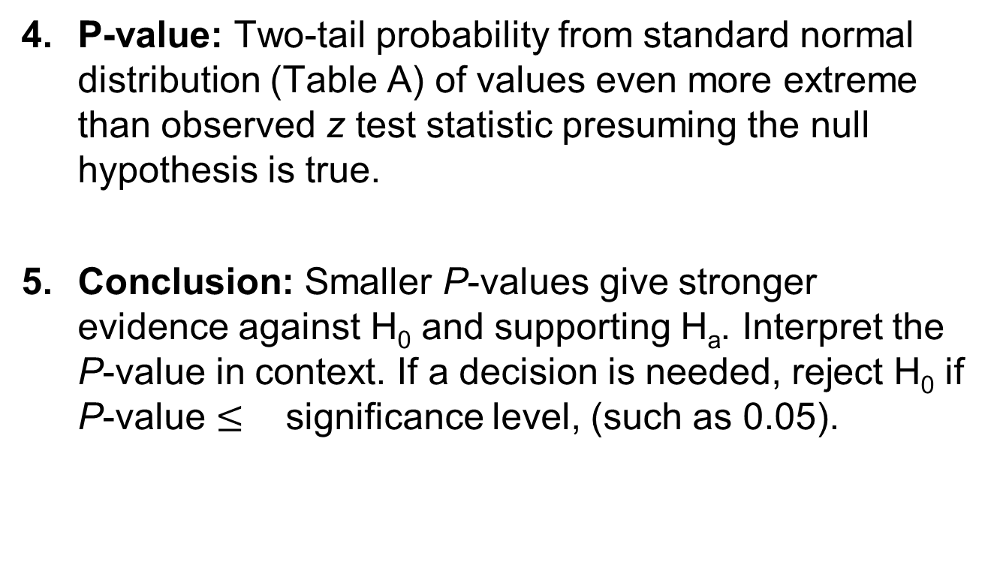
Two-Sided Significance Test for Comparing Two Population Proportions
P-value: Two-tail probability from standard normal distribution (Table A) of values even more extreme than observed z test statistic presuming the null hypothesis is true.
Conclusion: Smaller P-values give stronger evidence against H₀ and supporting H_{a}. Interpret the P-value in context. If a decision is needed, reject H₀ if P-value $≤$ significance level, (such as 0.05).
Notes:
22

Slide 23
Example: TV Watching and Aggressive Behavior
A study considered whether greater levels of television watching by teenagers were associated with a greater likelihood of aggressive behavior.
Researchers randomly sampled 707 families in two counties in New York state and made follow-up observations over 17 years.
Notes:
23

Slide 24
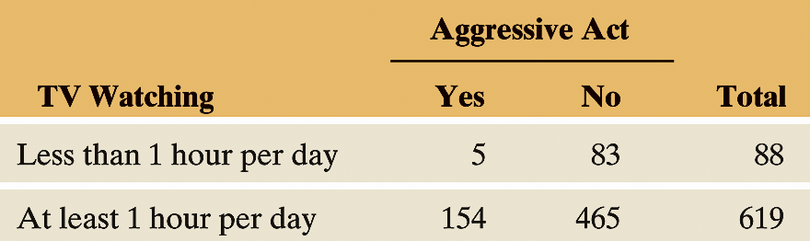
Example: TV Watching and Aggressive Behavior
Table 10.3 shows results about whether a sampled teenager later conducted any aggressive act against another person, according to a self-report by that person or by his or her parent.
Table 10.3 TV Watching by Teenagers and Later Aggressive Acts
Notes:
24

Slide 25
Example: TV Watching and Aggressive Behavior
Define Group 1 as those who watched less than 1 hour of TV per day, on the average, as teenagers.
Define Group 2 as those who averaged at least 1 hour of TV per day, as teenagers.
p₁ = population proportion committing aggressive acts
for the lower level of TV watching.
p₂ = population proportion committing aggressive acts
for the higher level of TV watching.
Notes:
25

Slide 26
Example: TV Watching and Aggressive Behavior
Test the Hypotheses:
using a significance level of 0.05.
Notes:
26

Slide 27
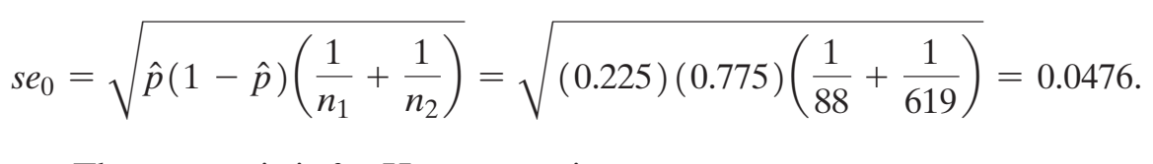
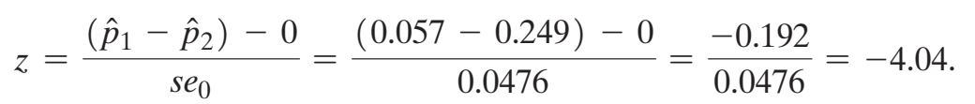
Example: TV Watching and Aggressive Behavior
Standard Error:
Test Statistic:
Notes:
27

Slide 28
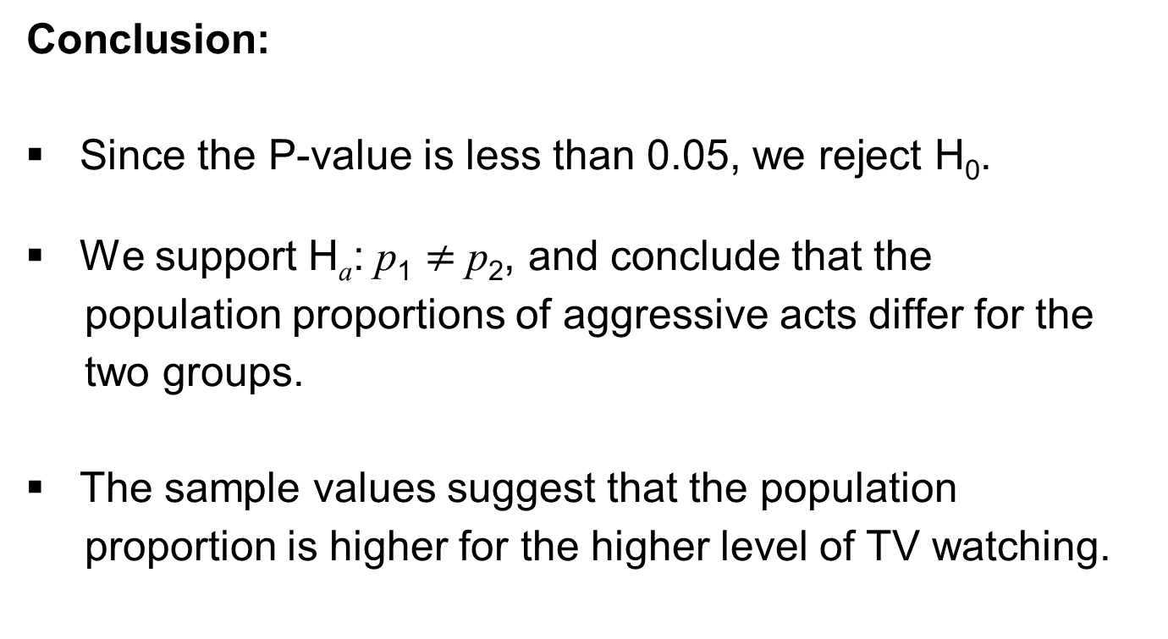
Example: TV Watching and Aggressive Behavior
Conclusion:
Since the P-value is less than 0.05, we reject H₀.
We support H_{a}: p₁ $≠$ p₂, and conclude that the
population proportions of aggressive acts differ for the
two groups.
The sample values suggest that the population
proportion is higher for the higher level of TV watching.
Notes:
28

Slide 29
Significant Difference
Two groups are called (statistically) significantly different if a test based on comparing the two population parameters results in a significant result, i.e., a small P-value.
Notes:
29

Slide 30
The Standard Error for Comparing Two Statistics
Standard Error of the Difference Between Two Estimates
For two estimates from independent samples, the standard error is
Notes:
30

Slide 31
Comparing Means
We can compare two groups on a quantitative response variable by comparing their means.
What does the difference between the sample means tell us about the difference between the population means?
Notes:
31

Slide 32
Example: A Graph Is Worth A Thousand Words
Participants randomly split into two groups:
One group read a short generic text about the effectiveness of a drug.
The other group read the same text, accompanied by a basic bar graph that mirrored the text.
Participants rated the perceived effectiveness of the drug on a 9-point scale (1- not at all and 9 - very effective).
Notes:
32

Slide 33
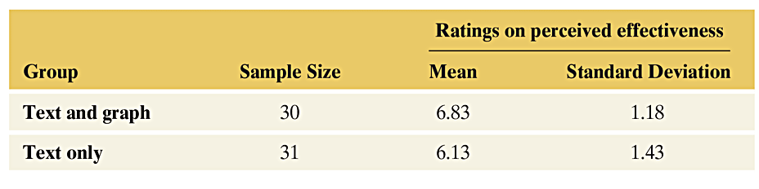
Example: A Graph Is Worth A Thousand Words
Table 10.5 Summary for Ratings on Perceived Effectiveness of Medication
Notes:
33

Slide 34
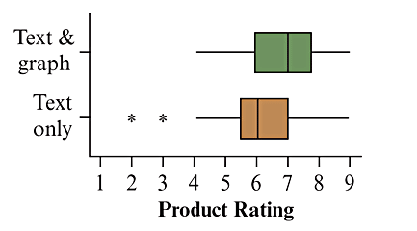
Example: A Graph Is Worth A Thousand Words
Figure 10.4 Side-by-Side Box Plots Showing the Distribution of Ratings in
the Two Groups. Question What other graph would you like to see?
Notes:
34

Slide 35
Example: A Graph Is Worth A Thousand Words
How can we compare the ratings between the group that saw the text and the graph and the group that just saw the text?
One way to compare the two groups compares the mean ratings by looking at their difference.
Group 1 is the one that read the text and saw the graph.
Group 2 is the one that just read the text.
Notes:
35

Slide 36

Example: A Graph Is Worth A Thousand Words
The sample mean rating is $\overline{x}1=$ 6.83 in Group 1 and $\overline{x}2=\text{6.13} \text{in} \text{Group}\text{ 2, }\text{resulting} \text{in} \text{a} \text{difference} \text{of} \overline{x}1\text{–} \overline{x}2=$ 6.83 – 6.13 = 0.7.
Table 10.5 Summary for Ratings on Perceived Effectiveness of Medication
Notes:
36

Slide 37
Example: A Graph Is Worth A Thousand Words
In this experiment, the mean rating on the perceived effectiveness of the medication is 0.7 points higher in the group that also saw the graph.
This analysis uses descriptive statistics only.
Notes:
37

Slide 38

Mean and Standard Deviation of the Sampling Distribution for the Difference of Two Sample Means
For two independent random samples of size n₁ and n₂ from two groups with population means $μ$₁ and $μ$₂ and population standard deviations $σ$₁ and $σ$₂, the sampling distribution of the difference in the sample means has mean = $μ$₁ – $μ$₂ and
Notes:
38

Slide 39
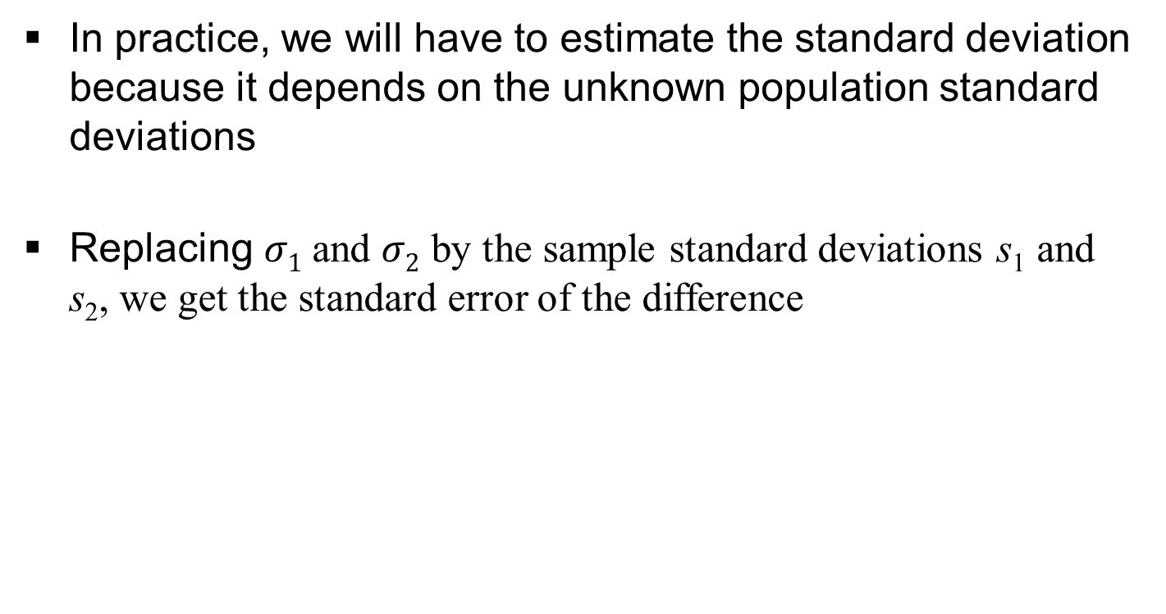
Standard Error for Comparing Two Means
In practice, we will have to estimate the standard deviation because it depends on the unknown population standard deviations
Replacing $σ1$and $σ2$ by the sample standard deviations s₁ and s₂, we get the standard error of the difference
Notes:
39

Slide 40

Confidence Interval for the Difference Between Population Means
For two samples with sizes n₁ and n₂ and standard deviations s₁ and s₂, a 95% confidence interval for the difference ($μ$₁ – $μ$₂) between the population means is
Software provides t_{.025}, the t-score with right-tail probability 0.025 (total probability = 0.95 between -t_{.025} and t_{.025}).
Notes:
40

Slide 41
Confidence Interval for the Difference Between Population Means
This method assumes:
A quantitative response variable observed in each of two groups.
Independent random samples from the two groups, either from random sampling or a randomized experiment.
An approximately normal population distribution for each group. (This is mainly important for small sample sizes, and even then the method is robust to violations of this assumption.)
Notes:
41

Slide 42
Example: Text with Graph
When using software to analyze the data, a 95% confidence interval for the difference between the mean product rating of the effectiveness of a drug between people who read a short description of the drug accompanied by a graph and people who just read the short description but did not see the graph equals [0.03, 1.38].
Is it reasonable to assume an approximate normal population distribution for product effectiveness ratings in the two groups? How does this affect inference?
Notes:
42

Slide 43
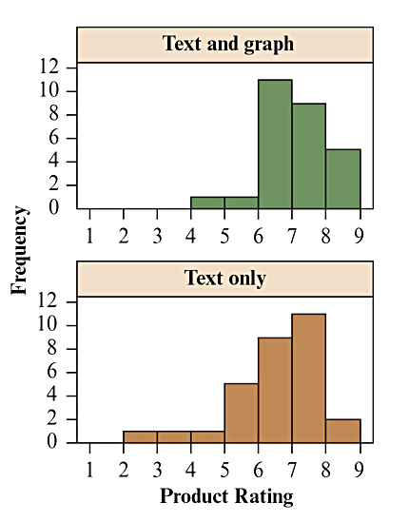
Example: Text with Graph
The side-by-side box plots shown earlier indicate a right skew for the Text and Graph group and a left skew for the Text Only group. However, the shape of the histograms doesn’t indicate any dramatic deviation from normality.
Also, the sample size is large enough for the central limit theorem to apply. Then the assumption of approximate normality of the population distribution of ratings in each group is less important.
Notes:
43

Slide 44
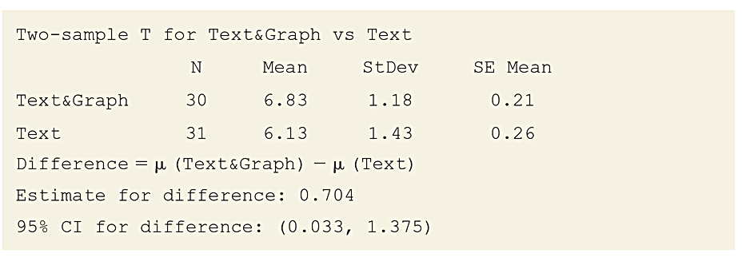
Example: Text with Graph
Show how the confidence interval was obtained and interpret it. The df value for the t-score, not shown in the computer output in Table 10.6, equals df = 57.5. With it, the t-score t_{0.025} = 2.002.
Table 10.6 MINITAB Output for Comparing Two Means
Notes:
44

Slide 45

Example: Text with Graph
See Footnote 5 in Chapter 10 for the formula of df
Notes:
45

Slide 46
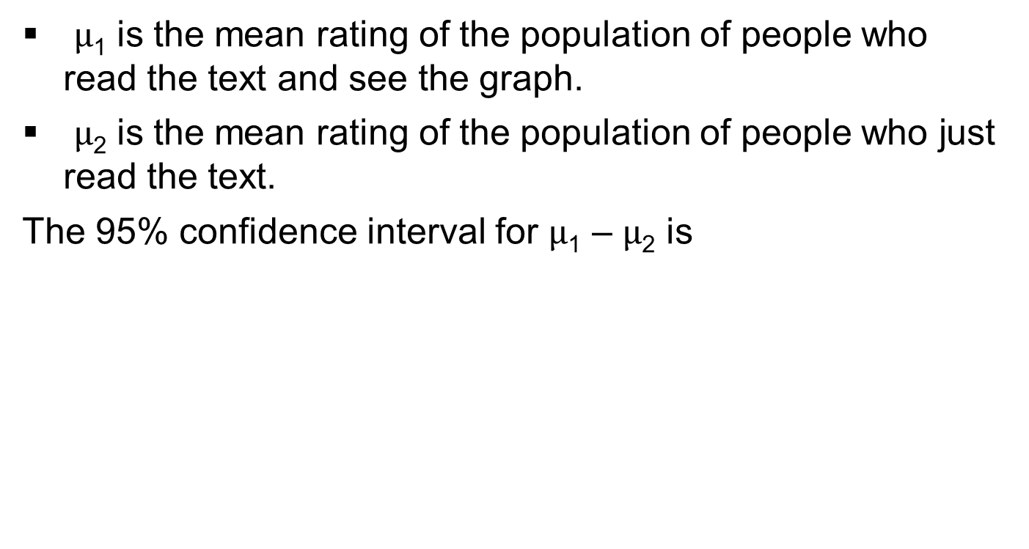
Example: Text with Graph
$μ$₁ is the mean rating of the population of people who read the text and see the graph.
$μ$₂ is the mean rating of the population of people who just read the text.
The 95% confidence interval for $μ$₁ – $μ$₂ is
Notes:
46

Slide 47
Example: Text with Graph
We can be 95% confident that the difference in the mean ratings between people reading the text and seeing the graph and people just reading the text falls between 0.03 points and 1.38 points.
Since this interval is completely above 0, we can infer that people who read the text and see the graph rate the drug’s effectiveness, on average, by as little as 0.03 points and as much as 1.38 points higher (on a 9-point scale).
Notes:
47

Slide 48
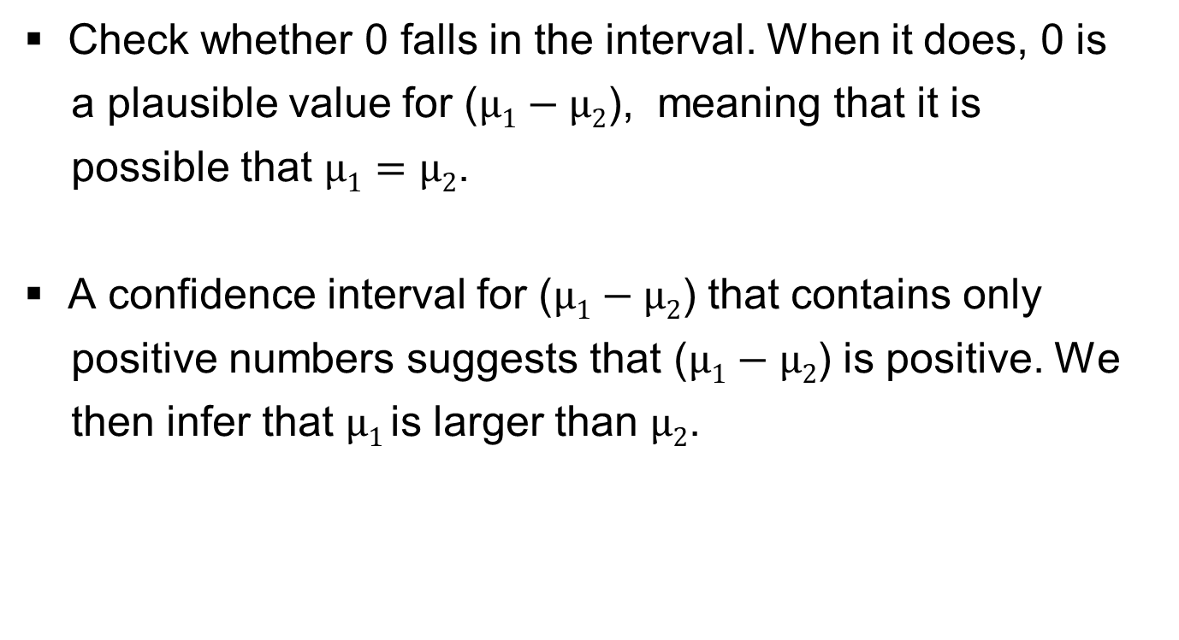
Interpret a Confidence Interval for a Difference of Means
Check whether 0 falls in the interval. When it does, 0 is
a plausible value for ($μ1−μ2$), meaning that it is
possible that $μ1=μ2$.
A confidence interval for ($μ1−μ2$) that contains only
positive numbers suggests that ($μ1−μ2$) is positive. We
then infer that $μ1$is larger than $μ2$.
Notes:
48

Slide 49
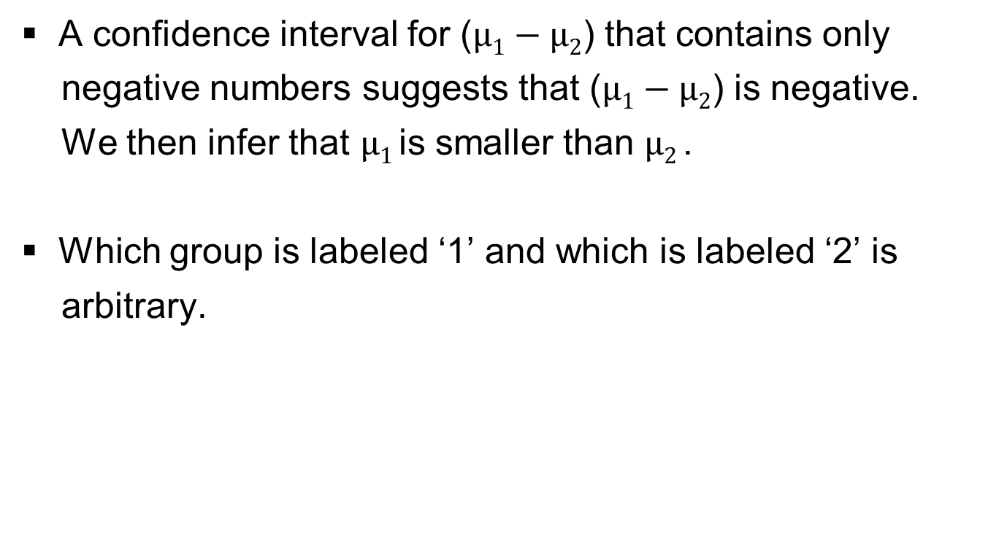
Interpret a Confidence Interval for a Difference of Means
A confidence interval for ($μ1−μ2$) that contains only
negative numbers suggests that ($μ1−μ2$) is negative.
We then infer that $μ1$is smaller than $μ2$.
Which group is labeled ‘1’ and which is labeled ‘2’ is
arbitrary.
Notes:
49

Slide 50
SUMMARY: Two-Sided Significance Test for Comparing Two Population Means
1. Assumptions
  A quantitative response variable observed in each of two groups
  Independent random samples
  Approximately normal population distribution for each group (This is mainly important for small sample sizes, and even then the two-sided test is robust to violations of this assumption).
Notes:
50

Slide 51
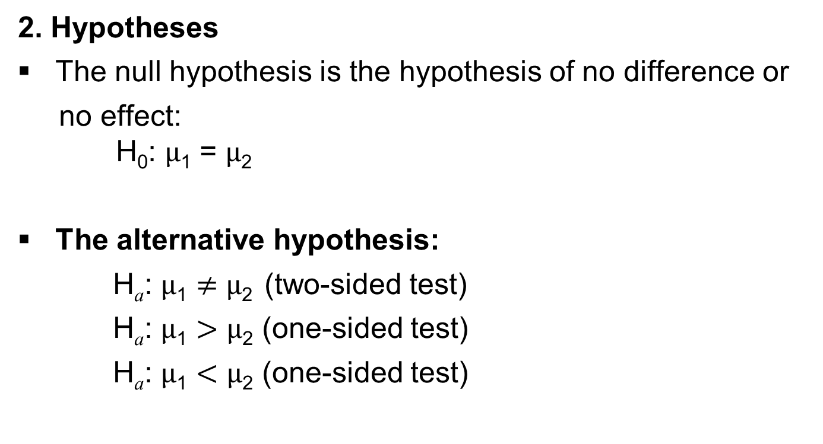
SUMMARY: Two-Sided Significance Test for Comparing Two Population Means
2. Hypotheses
The null hypothesis is the hypothesis of no difference or
no effect:
H₀: $μ$₁ = $μ$₂
The alternative hypothesis:
H_{a}: $μ$₁ $≠$ $μ$₂ (two-sided test)
H_{a}: $μ$₁ $>$ $μ$₂ (one-sided test)
H_{a}: $μ$₁ $<$ $μ$₂ (one-sided test)
Notes:
51

Slide 52
SUMMARY: Two-Sided Significance Test for Comparing Two Population Means
3. Test Statistic
Notes:
52

Slide 53
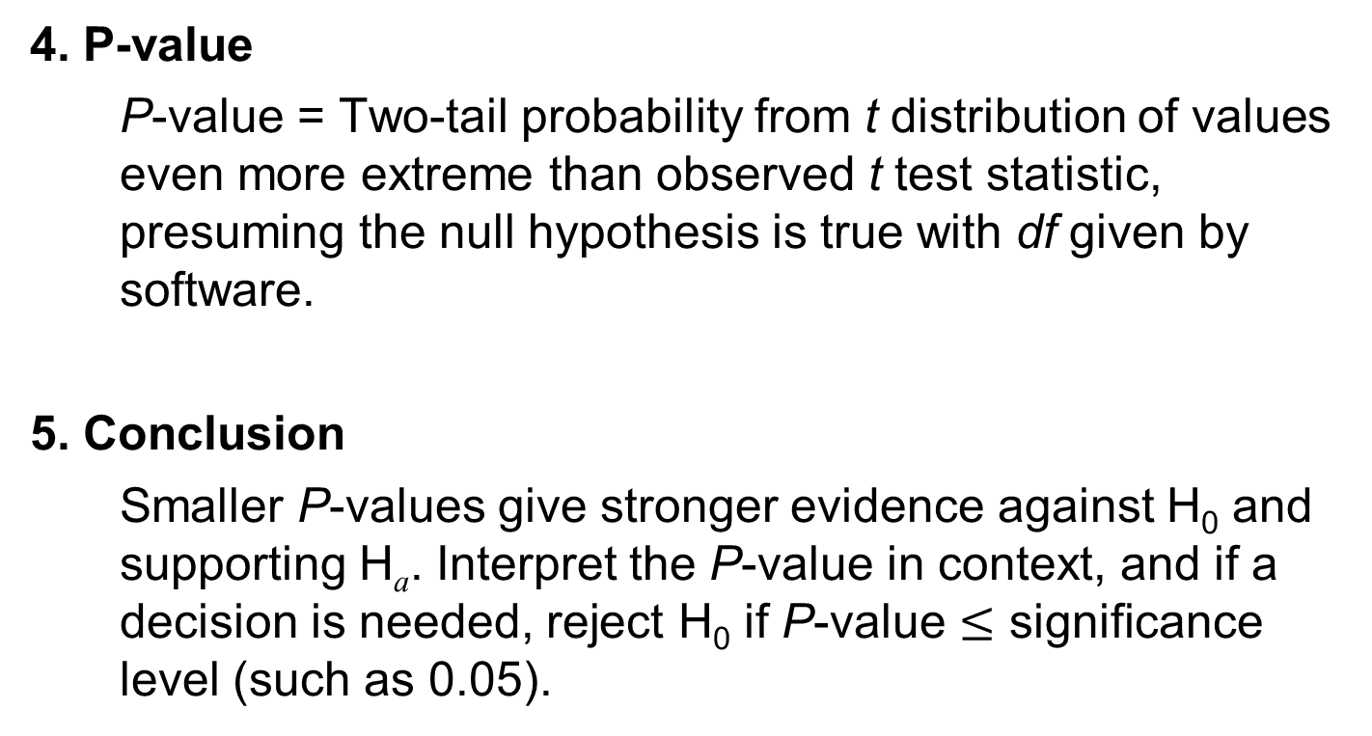
SUMMARY: Two-Sided Significance Test for Comparing Two Population Means
4. P-value
  P-value = Two-tail probability from t distribution of values even more extreme than observed t test statistic, presuming the null hypothesis is true with df given by software.
5. Conclusion
  Smaller P-values give stronger evidence against H₀ and supporting H_{a}. Interpret the P-value in context, and if a decision is needed, reject H₀ if P-value $≤$ significance level (such as 0.05).
Notes:
53

Slide 54
Example: Cell Phone Use While Driving Impair Reaction Times
An experiment investigated whether cell phone use impairs drivers’ reaction times, using a sample of students from the University of Utah.
Experiment:
  64 college students
  32 were randomly assigned to the cell phone group
  32 to the control group
Notes:
54

Slide 55
Example: Cell Phone Use While Driving Impair Reaction Times
Experiment (continued):
  Students used a machine that simulated driving situations.
  At irregular periods a target flashed red or green.
  Participants were instructed to press a “brake button” as soon as possible when they detected a red light.
  The control group listened to radio or books-on-tape while they performed the simulated driving. The cell phone group carried out a phone conversation about a political issue with someone in a separate room.
Notes:
55

Slide 56
Example: Cell Phone Use While Driving Impair Reaction Times
For each subject, the experiment analyzed their mean response time over all the trials.
Averaged over all trials and subjects, the mean response time for the cell-phone group was 585.2 milliseconds.
The mean response time for the control group was 533.7 milliseconds.
Notes:
56

Slide 57
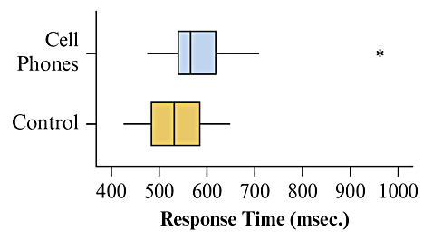
Example: Cell Phone Use While Driving Impair Reaction Times
Boxplots of data:
Figure 10.6 MINITAB Box Plots of Response Times for Cell Phone Study.
Question: Does either box plot show any irregularities that could affect the analysis?
Notes:
57

Slide 58
Example: Cell Phone Use While Driving Impair Reaction Times
Test the hypotheses:
against
  using a significance level of 0.05.
Notes:
58

Slide 59
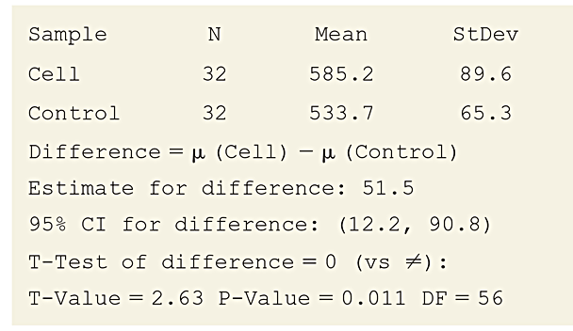
Example: Cell Phone Use While Driving Impair Reaction Times
Table 10.7 MINITAB Output Comparing Mean Response Times for Cell Phone
and Control Groups
Notes:
59

Slide 60
Example: Cell Phone Use While Driving Impair Reaction Times
Conclusion:
  The P-value is less than 0.05, so we can reject H_{0.}
  There is enough evidence to conclude that the population mean response times differ between the cell phone and control groups.
  The sample means suggest that the population mean is higher for the cell phone group.
Notes:
60

Slide 61
Example: Cell Phone Use While Driving Impair Reaction Times
What do the box plots tell us?
  There is an extreme outlier for the cell phone group.
  It is a good idea to make sure the results of the analysis aren’t affected too strongly by that single observation.
  Delete the extreme outlier and redo the analysis.
  The mean and standard deviation for the cell phone group now decrease substantially. However, the t test statistic is not much different, and the P-value is still small, 0.015, leading to the same conclusion.
Notes:
61

Slide 62
Example: Cell Phone Use While Driving Impair Reaction Times
Insight:
  In practice, you should not delete outliers from a data set without sufficient cause (i.e., if it seems the observation was incorrectly recorded).
  It is, however, a good idea to check for sensitivity of an analysis to an outlier.
  If the results change much, it means that the inference including the outlier is on shaky ground.
Notes:
62

Slide 63
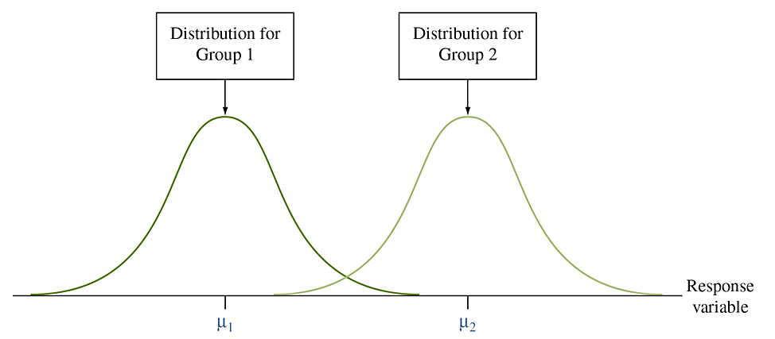
Comparing Means, Assuming Equal Population Standard Deviations
An alternative t-method can be used when, under the null hypothesis, it is reasonable to expect the variability as well as the mean to be the same.
This method requires the assumption that the population standard deviations be equal.
Figure 10.7 Two Groups With Equal Population Standard Deviations. Question: What would a graph of the sample data look like to make you doubt this assumption?
Notes:
63

Slide 64

The Pooled Standard Deviation
This alternative method estimates the common value $σ$ of
$σ$₁ and $σ$₂ by:
The degrees of freedom for this method are df = n₁ + n₂ – 2,
which appears in the denominator of the formula for s.
Notes:
64

Slide 65

SUMMARY: Comparing Population Means, Assuming Equal Population Standard Deviations
Using the pooled standard deviation estimate s of $σ=σ1=σ$₂, the standard error of ($\overline{x}$₁ – $\overline{x}$₂) simplifies to
Notes:
65

Slide 66
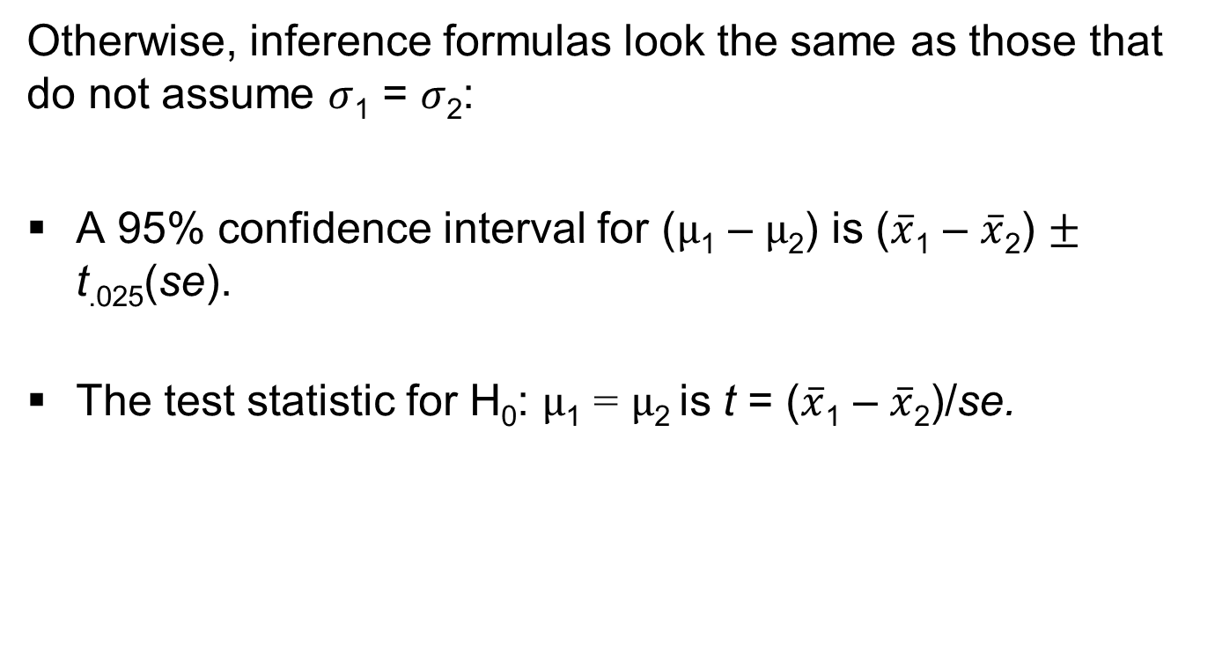
SUMMARY: Comparing Population Means, Assuming Equal Population Standard Deviations
Otherwise, inference formulas look the same as those that do not assume $σ$₁ = $σ$₂:
A 95% confidence interval for ($μ$₁ – $μ$₂) is ($\overline{x}$₁ – $\overline{x}$₂) $±$ t_{.025}(se).
The test statistic for H₀: $μ$₁ = $μ$₂ is t = ($\overline{x}$₁ – $\overline{x}$₂)/se.
Notes:
66

Slide 67
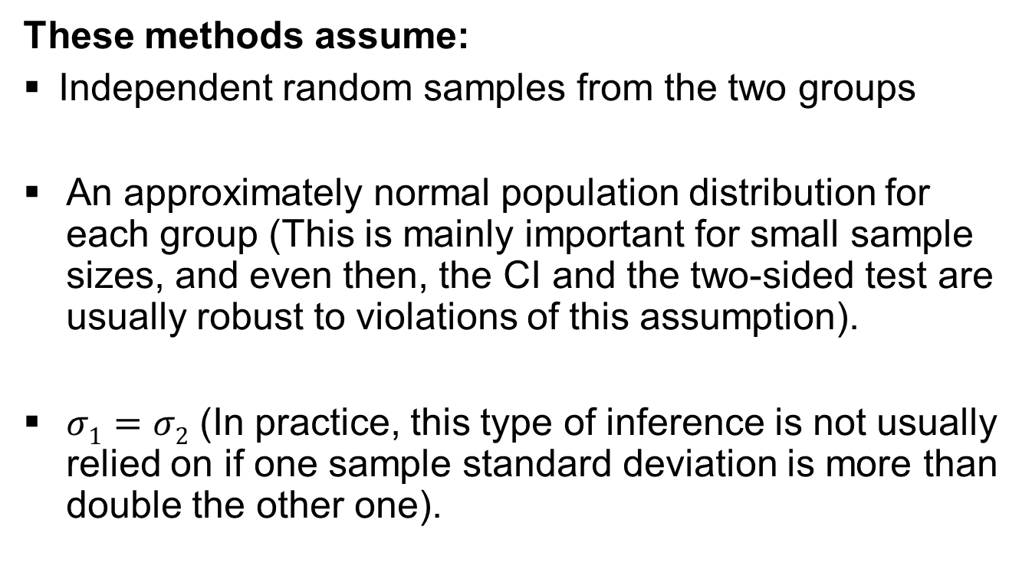
SUMMARY: Comparing Population Means, Assuming Equal Population Standard Deviations
  These methods assume:
  Independent random samples from the two groups
  An approximately normal population distribution for each group (This is mainly important for small sample sizes, and even then, the CI and the two-sided test are usually robust to violations of this assumption).
  $σ1=σ2$ (In practice, this type of inference is not usually relied on if one sample standard deviation is more than double the other one).
Notes:
67

